Slide 1
Web Application Security
CSC 481/681/781
Principles of Computer Security
Reference: Goodrich and Tamassia, Chapter 7
and OWASP Top 10

Slide 2
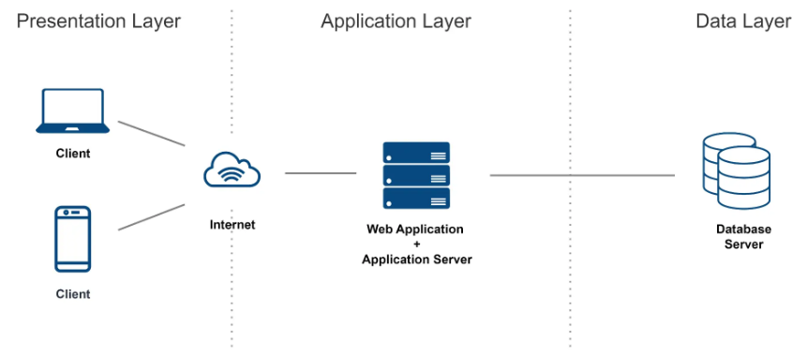
Web Applications Model
Web Development depends on a lot of technologies
HTTP/HTTPS
PHP
SQL
HTML/CSS/JavaScript

Slide 3
Web Applications Model
Web Development depends on a lot of technologies
Consider this side
HTTP/HTTPS
PHP
SQL
HTML/CSS/JavaScript

Slide 4
Web Content/Rendering
“Content” here means data delivered to browser, not all server data
Straight web content (no special plugins!) has 3 components:
HTML (HyperText Markup Language) - gives overall structure to content
CSS (Cascading Style Sheets) - gives rendering/formatting information
JavaScript - code that can respond to events, change content, communicate with server, ...
<html>
<body>
<div id='outer'>
<div id='inner1'>
Inner block
</div>
<div id='inner2'>
Second inner block
</div>
</div>
</body>
</html>
HTML: Structures content
Can be viewed as a text document
Can be modeled as objects: The DOM

Slide 5
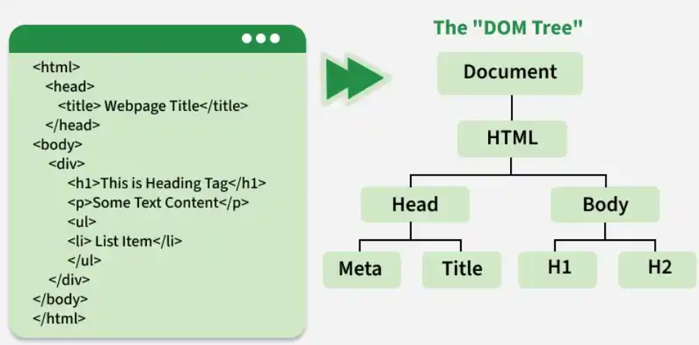
Web Content/Rendering
“Content” here means data delivered to browser, not all server data
The Document Object Model (DOM)
DOM tree reflects nesting of HTML tags
Gives JavaScript access to content
Can browse hierarchy, starting at “document”
Can locate an item by name:
Ex: document.getElementById('inner2’)
Ex: document.getElementById('inner2').textContent = "Hi!";
The DOM is a tree representation of a webpage that allows JavaScript to read and modify content.

Slide 6
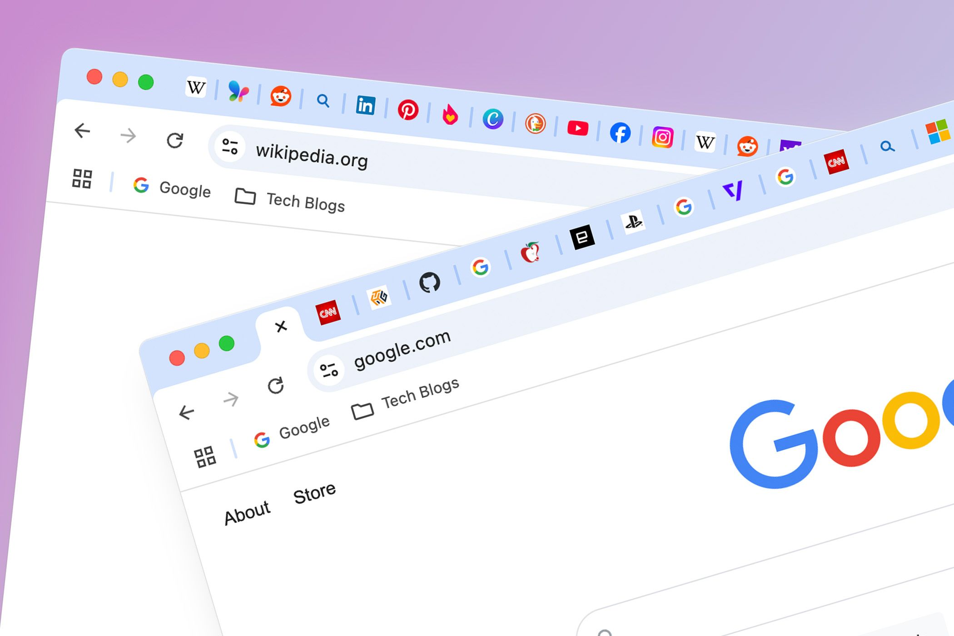
Isolation in the Web Browser
Generally based on windows/frames
Idea: One tab/window/frame shouldn’t be able to read/change info from another website
Same-Origin Policy (SOP):
One website should not be able to read or change data from another website.
Understanding “Origin”:
proto://host:port/
Protocol: Such as HTTP or HTTPS
Host: Such as example.com
Port number: Such as 80 (default for HTTP) or 443 (default for HTTPS)

Slide 7
Isolation in the Web Browser
Generally based on windows/frames
Idea: One tab/window/frame shouldn’t be able to read/change info from another website
URL A URL B Same Origin?
URL A: https://example.com/page1
URL B: https://example.com/page2
URL A:
https://example.com
URL B:
http://example.com
Yes! Same protocol, host, and port.
No! Different protocol.

Slide 8
Isolation in the Web Browser
Generally based on windows/frames
Idea: One tab/window/frame shouldn’t be able to read/change info from another website
URL A URL B Same Origin?
URL A:
https://example.com
URL B: https://api.example.com
URL A:
https://example.com
URL B:
https://example.com:8080
No! Different host.
No! Different port.

Slide 9
Isolation in the Web Browser
Generally based on windows/frames
Idea: One tab/window/frame shouldn’t be able to read/change info from another website
URL A URL B Same Origin?
URL A:
https://example.com/app
URL B: https://example.com/api
Yes! Paths don't affect origin

Slide 10
Isolation in the Web Browser
Generally based on windows/frames
Same-Origin Policy: What It Restricts
DOM Access:
Cannot read or modify DOM of another origin
Scripts only interact with their own webpage
Cookies & Storage
Access limited to same origin only
Protects sensitive data (e.g., session IDs, tokens)
Network Requests (AJAX / Fetch)
Requests allowed only to same origin by default
Cross-origin requests require CORS (controlled permission)

Slide 11
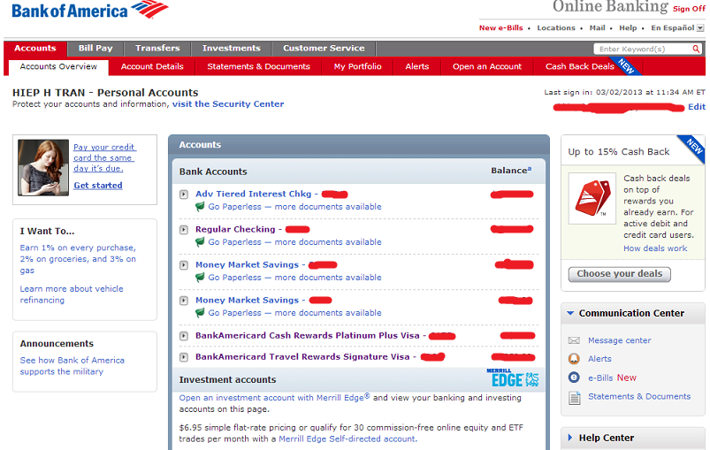
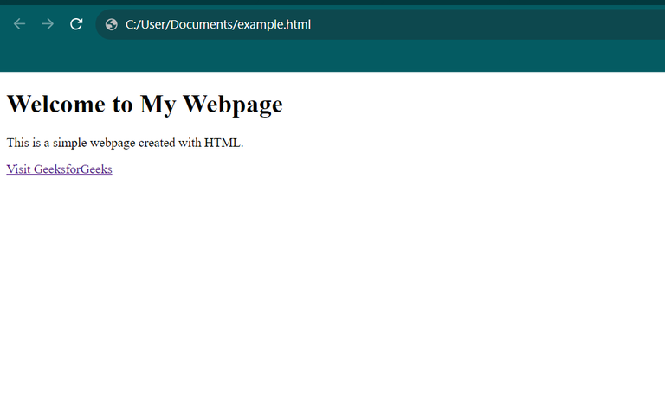

Isolation in the Web Browser
Generally based on windows/frames
Make transfer requests, modify the content…
Read your bank account details, steal your credentials, …

Slide 12


Client-Side Programs: JavaScript Basic Information
Originally designed for: Input validation, some local computation, and some interaction
Now used for full applications running in browser!
JavaScript was created in 10 days by Brendan Eich.
JavaScript’s original name was Mocha.
JavaScript has nothing to do with Java.
Microsoft created a ‘reverse-engineered’ version of JavaScript, know as JScript.

Slide 13
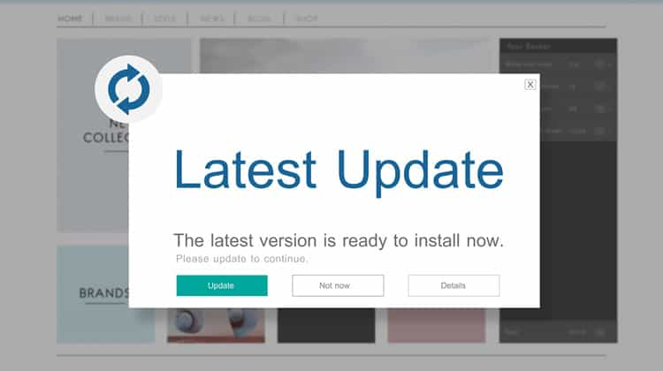
Client-Side Programs: JavaScript Basic Information
Embedded in HTML element:
Once the page loads, JavaScript can interact with the webpage in many ways:
Modify content: “Read and change page elements (via the DOM)”
Handle user input: “Read and update form values”
Interact with user: “Show alerts or pop-ups”
Manage browser data: “Read and write cookies”
<script language="JavaScript">
alert("Entering a JavaScript-enabled page!");
</script>

Slide 14
Client-Side Programs: JavaScript Input checking example
Defined in page header:
Defined in page body:
function checkSubmit() {
var test = parseFloat(document.inputform.age.value,10);
if (test == document.inputform.age.value*1)
return true;
else {
alert("Must enter a number for age.");
return false;
}
}
<form name="inputform" onsubmit="return checkSubmit();"
action="inputgood.html">
Enter your age:
<input type="text" name="age" size=10 /><br><br>
<input type="submit" value="Submit Value" />
</form>
“Action” done only if function returns true
WARNING: Server should re-validate inputs (never trust software on the other side of a network connection!)
Client-side validation improves usability, but server-side validation ensures security.

Slide 15
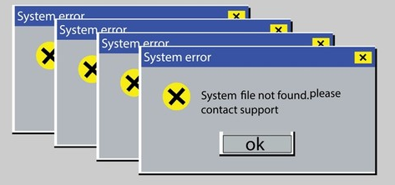
Client-Side Programs: JavaScript Some basic security issues
Basic issues with language in browser:
Annoying / Resource exhausting pop-up windows
Ex: Two new windows for each one closed
Mozilla/Firefox can be configured for no pop-ups
CPU / Memory exhaustion attacks
Modern browsers detect CPU monopolization

Slide 16
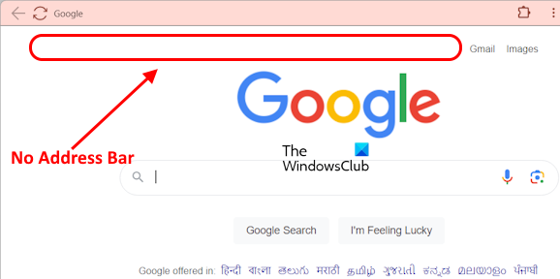
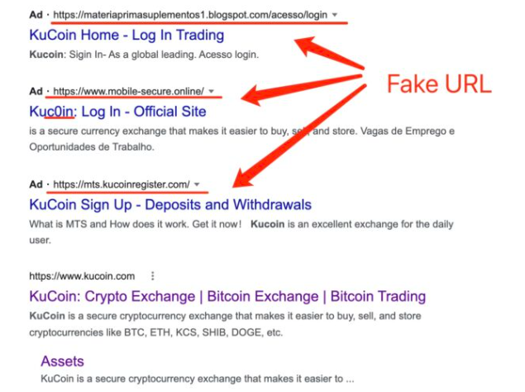
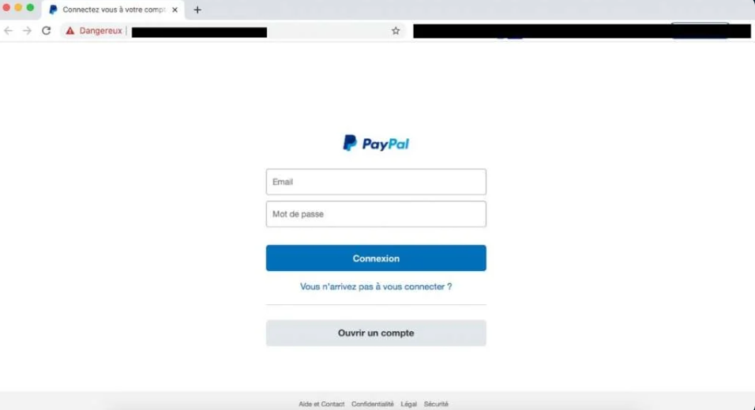
Client-Side Programs: JavaScript Some basic security issues
Basic issues with language in browser:
Spoofing attacks:
Misleading status line / link target
Hide address bar at top and have a “mirror site”

Slide 17



JavaScript Cross-Site Scripting (XSS)
Cross Site Scripting (XSS): XSS is a vulnerability which when present in websites or web applications, allows malicious users to insert their client-side code (normally JavaScript) in those web pages. When this malicious code along with the original webpage gets displayed in the web client, allows Hackers to gain greater access of that page.
1. User post a thread via HTTP POST
(POST: “I’ve created a list of more than 200 interesting questions. Comment a number and I’ll ask you one!”)

Slide 18
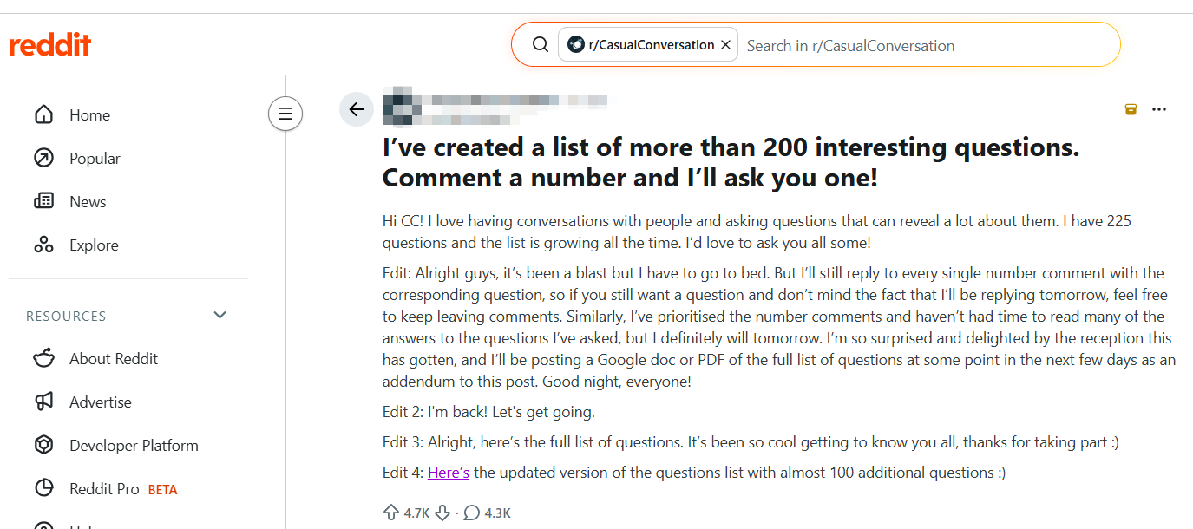
JavaScript Cross-Site Scripting (XSS)
Cross Site Scripting (XSS): XSS is a vulnerability which when present in websites or web applications, allows malicious users to insert their client-side code (normally JavaScript) in those web pages. When this malicious code along with the original webpage gets displayed in the web client, allows Hackers to gain greater access of that page.
2. Server stores post in database.

Slide 19

JavaScript Cross-Site Scripting (XSS)
Cross Site Scripting (XSS): XSS is a vulnerability which when present in websites or web applications, allows malicious users to insert their client-side code (normally JavaScript) in those web pages. When this malicious code along with the original webpage gets displayed in the web client, allows Hackers to gain greater access of that page.
3. Associate requests the post page
(GET: interesting questions on reddit)

Slide 20
JavaScript Cross-Site Scripting (XSS)
Cross Site Scripting (XSS): XSS is a vulnerability which when present in websites or web applications, allows malicious users to insert their client-side code (normally JavaScript) in those web pages. When this malicious code along with the original webpage gets displayed in the web client, allows Hackers to gain greater access of that page.
4. Server retrieves all posts related from DB

Slide 21

JavaScript Cross-Site Scripting (XSS)
Stored XSS
Attacker post a thread via HTTP POST
(POST: <script>doEvil()</script> “I’ve created a list of more than 200 interesting questions. Comment a number and I’ll ask you one!”)

Slide 22
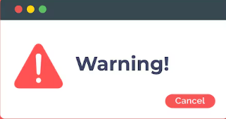
JavaScript Cross-Site Scripting (XSS)
Stored XSS
PHP CODE: <? echo "<div class=’question'>$question</div>";?>
HTML Code: <div class=’question'><script>doEvil()</script></div>
Attacker post a thread via HTTP POST
(POST: <script>doEvil()</script> “I’ve created a list of more than 200 interesting questions. Comment a number and I’ll ask you one!”)

Slide 23

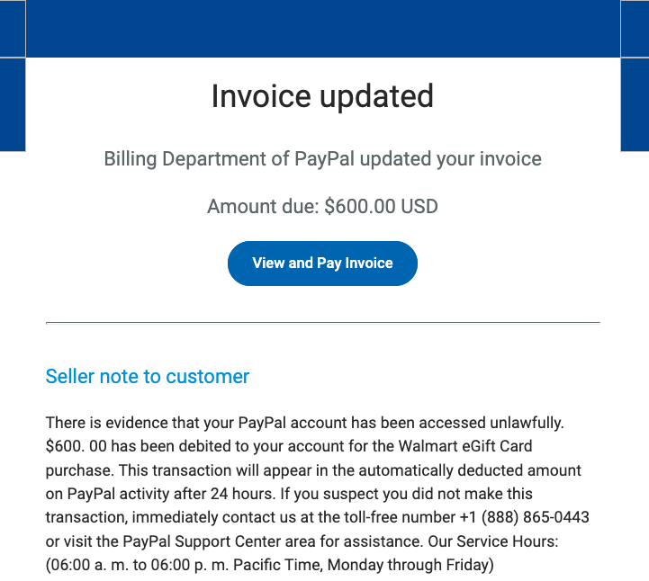
JavaScript Cross-Site Scripting (XSS)
Reflected XSS (connect to phishing)
1. Attacker send email with malicious link
safebank.com/search.php?query=<script>doEvil()</script>

Slide 24
JavaScript Cross-Site Scripting (XSS)
Reflected XSS (connect to phishing)
2. The user is tricked into opening the link and requesting the malicious URL from the Secure website

Slide 25
JavaScript Cross-Site Scripting (XSS)
Reflected XSS (connect to phishing)
3. The website includes the malicious string in its response to the user

Slide 26
JavaScript Cross-Site Scripting (XSS)
Reflected XSS (connect to phishing)
4. The user’s sensitive information is sent to the attacker’s server

Slide 27
JavaScript Cross-Site Scripting (XSS)
DOM-based XSS (slightly more advanced)
1. Attacker send email with malicious link
safebank.com/search.php#<script>doEvil()</script>

Slide 28
JavaScript Cross-Site Scripting (XSS)
DOM-based XSS (slightly more advanced)
2. Client-side JavaScript reads the URL. The code trusts the input and directly injects it into the page.
var data = location.hash
document.getElementById("output").innerHTML = data

Slide 29
JavaScript Cross-Site Scripting (XSS)
DOM-based XSS (slightly more advanced)
3. The website receives the request, but does not include the malicious string in the response

Slide 30
JavaScript Cross-Site Scripting (XSS)
DOM-based XSS (slightly more advanced)
4. The user’s browser executes the malicious script inserted into the page by the client-side code

Slide 31
JavaScript Cross-Site Scripting (XSS)
DOM-based XSS (slightly more advanced)
5. The user’s sensitive information is sent to the attacker’s server

Slide 32
JavaScript Cross-Site Scripting (XSS)
What sort of sensitive information?
Cookies: Including authentication tokens
Form fields (including hidden form fields)
Data retrievable by XMLHttpRequest
Indirectly: Account information, Billing information, …

Slide 33
JavaScript Cross-Site Scripting (XSS)
Protecting against XSS vulnerabilities:
Protection 1: When users submit data (like comments) that will be reflected to other users, strip all HTML except safe tags:
Might allow <p>, <b>, <i>, or even <a>
But – code can hide in tag attributes as well!
In some cases remove all HTML
In PHP: “striptags” built-in function
Clean the user input before displaying it

Slide 34
JavaScript Cross-Site Scripting (XSS)
Protecting against XSS vulnerabilities:
Protection 2: Content Security Policy (CSP) can restrict where “executable code” comes from
Can separate all code into trusted, static files and only allow those to execute
Can allow based on origin (domain), context (inline vs loaded), specific trust (give a cryptographic hash of trusted code), or tagged with nonce
Enforcing this is up to the browser, but XSS is an attack on the browser from outside party - not a “bad client” attack
No single defense is enough—XSS protection requires multiple layers

Slide 35
Server-Side Vulnerability
SQL Injection
Typical web application:
Web Server
Interacts with user
and presents data
Database
Gets data for server
application
Requests are made in “Structured
Query Language” (SQL)
Examples:
select * from transactions where sourceacct=‘user’
select * from userid where id=‘name’

Slide 36
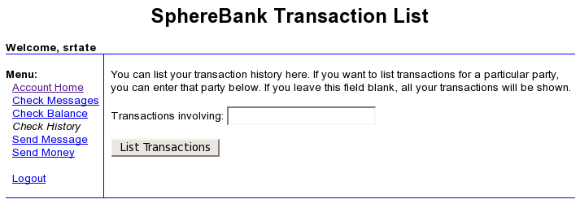
Server-Side Vulnerability
SQL Injection
Goal: Pull in transactions involving this user and some other specified user.
Input field goes into variable $userinput
SELECT moneyfrom, moneyto, transdate, amount FROM transactions WHERE moneyfrom='srtate' and moneyto='$userinput'
So, user entering gonzo results in:
SELECT moneyfrom, moneyto, transdate, amount FROM transactions WHERE moneyfrom='srtate' and moneyto='gonzo'

Slide 37
Server-Side Vulnerability
SQL Injection
This is the correct result, but…
What if user is tricky and enters: gonzo' or 'x'='x
Resulting SQL: … where moneyfrom='srtate' and moneyto='gonzo' or 'x'='x'
Matches all records!

Slide 38
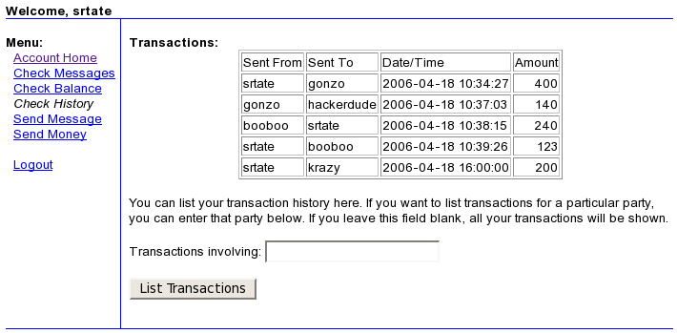
Server-Side Vulnerability
SQL Injection
Result shown above
Note transactions not involving srtate are shown!

Slide 39


Server-Side Vulnerability
SQL Injection
In some systems can do much more:
Inject “… ; drop table users”
Can modify data (increase balances?)
Note: “Data” used as transport for
executable statements!

Slide 40
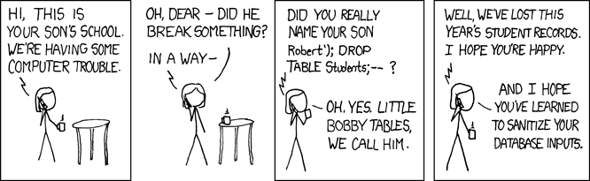
Server-Side Vulnerability
SQL Injection
https://xkcd.com/327/
https://tryhackme.com/room/sqlilab

Slide 41
Server-Side Vulnerability
SQL Injection – Protections
At the very least: Escape quotes so they don’t end a string
So (gonzo' or 'x'='x) becomes (gonzo\' or \'x\'=\'x)
Can’t “get out” of string to executable statements
In PHP use built-in “addslashes” function
Or… turn on “magicquotes” option to do automatically!
The correct/best protection:
Don’t use inputs in SQL statements: use parameterized statements
Semi-automated techniques
Taint analysis
Potentially dangerous variables flagged, and everything they affect flagged
Flags cleared by explicit checking/filtering tainted variables
Built-in to Perl and Ruby

